Slide 1

Data Decoy
Denise Blady
Eric Lehner
Guru Prasad
Brian Rosenberg
github.com/bjr24/DataDecoy

Slide 2
What DataDecoy can do?
Protects user's location
Allows users to withhold real location data
Defeats Android’s all or nothing permission model
Decoys location data at the application-level
Mirrors real user movement in mock data
Trace files can give mock locations
Users benefit from promotions/coupons

Slide 3
Demonstrations
Automatic Mocking with Foursquare
Manual Mocking with Foursquare including making GPS traces through the UI
Injecting GPS coordinates

Slide 4
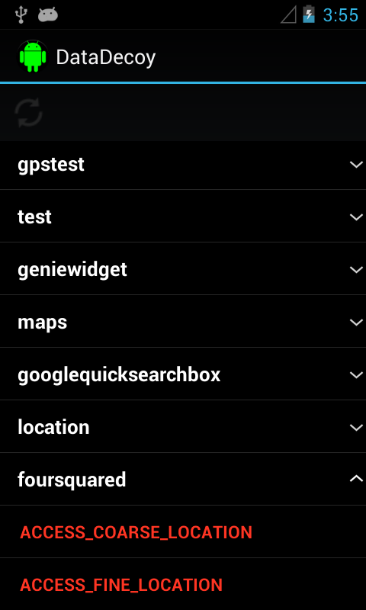
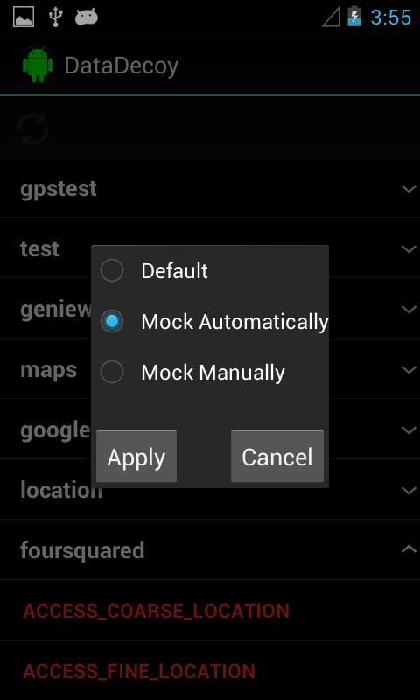

Slide 5
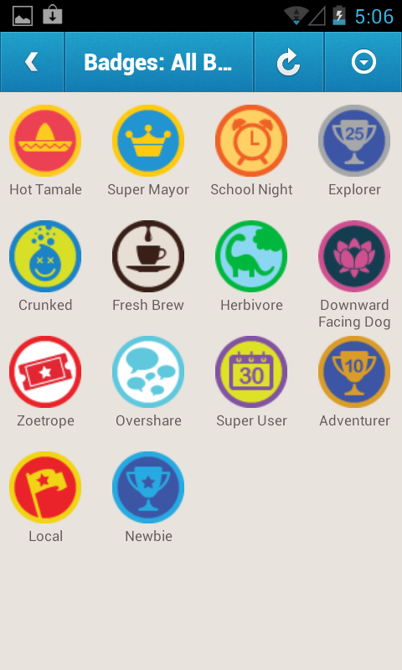

Slide 6
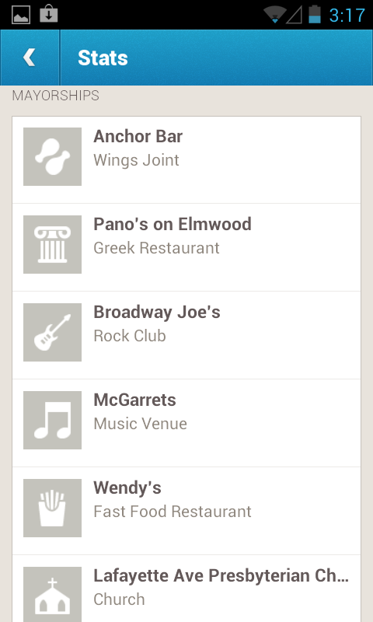
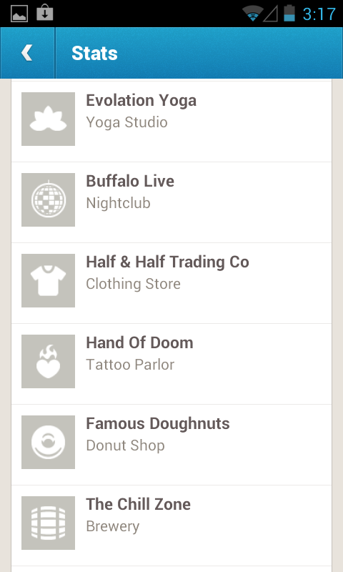
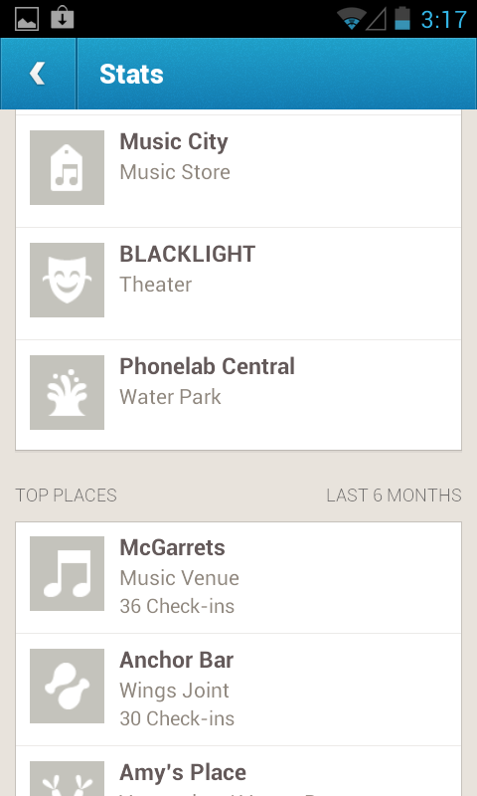

Slide 7
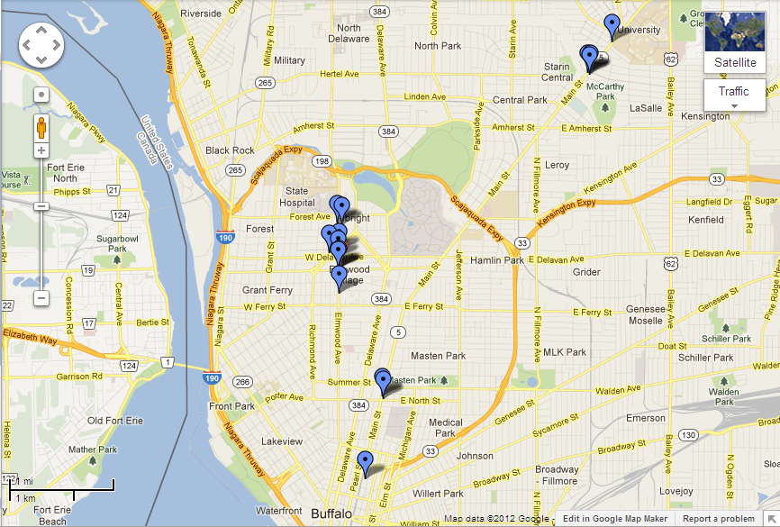

Slide 8
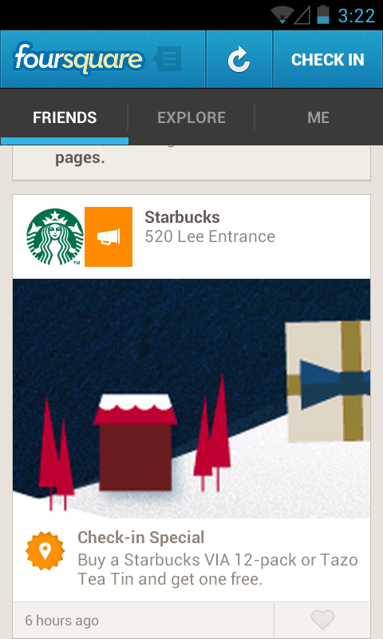
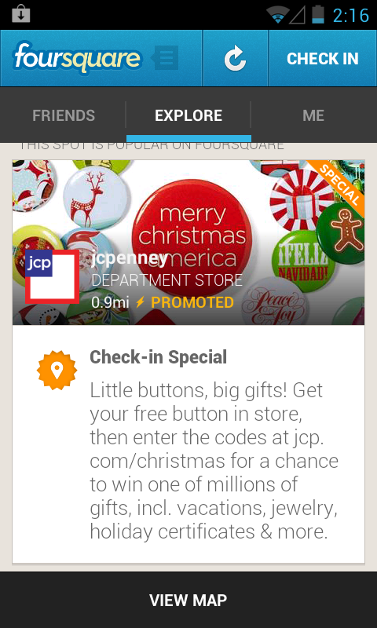
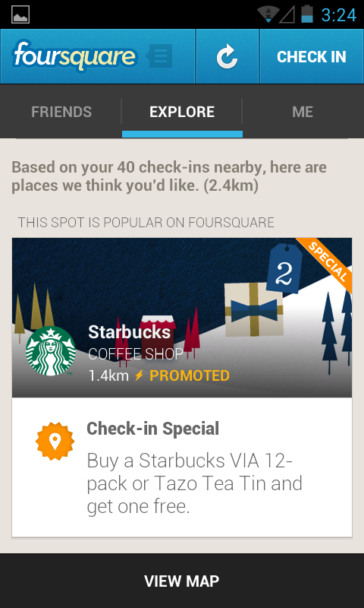
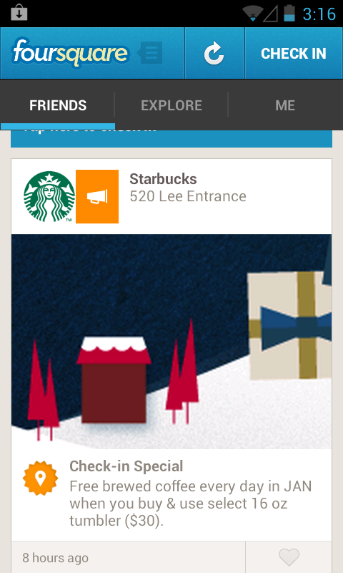
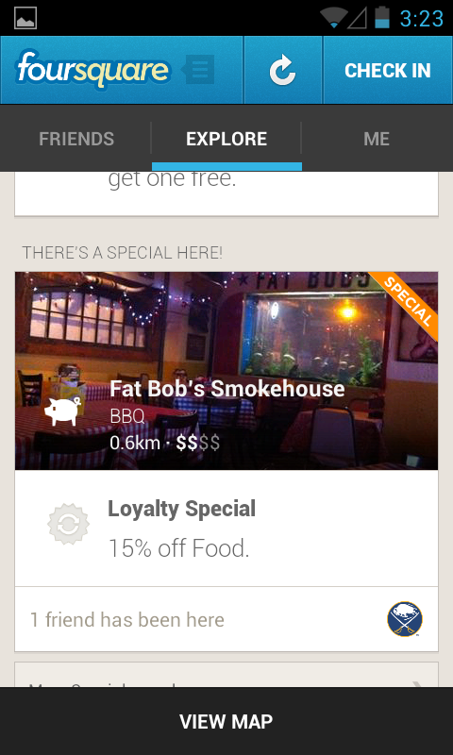
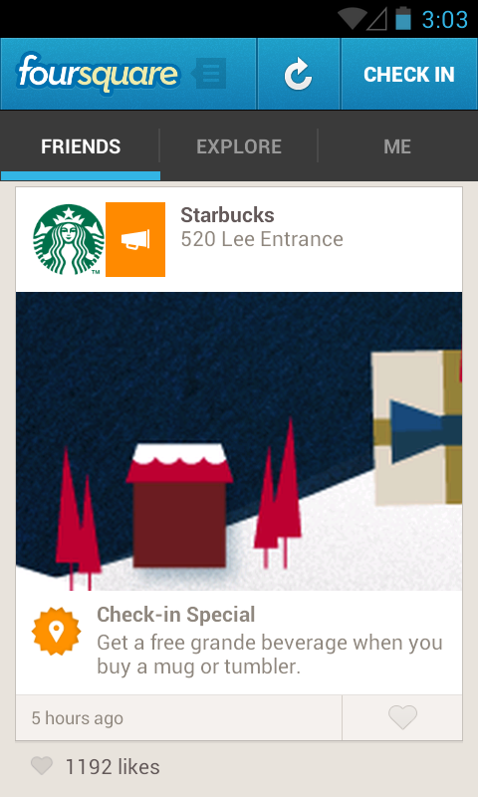
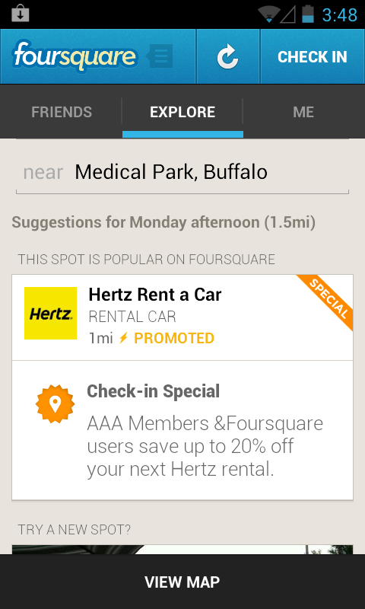
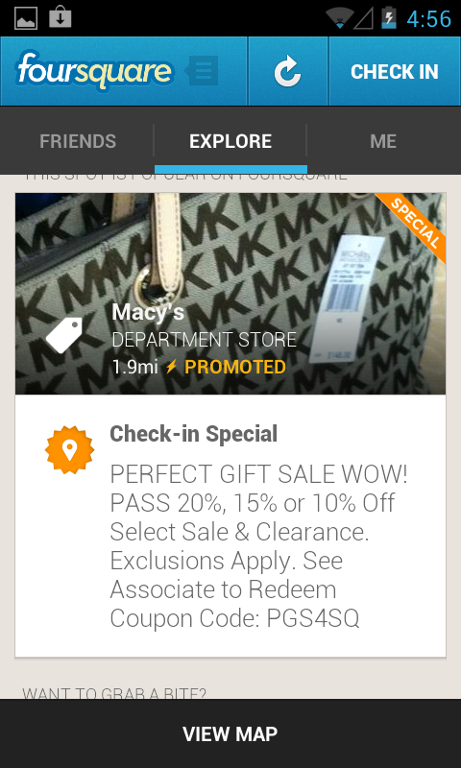

Slide 9
Demonstrations
Automatic Mocking with Foursquare
Manual Mocking with Foursquare including making GPS traces through the UI
Injecting GPS coordinates

Slide 10
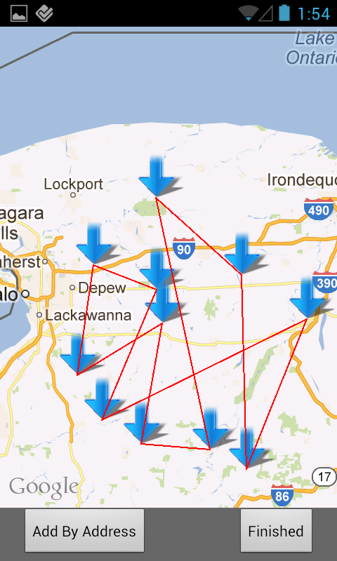
Process
Takes you to a new screen
Allows you to enter on a map via long touch.
Allows addresses to be added manually.
Creates a trace from entered points

Slide 11
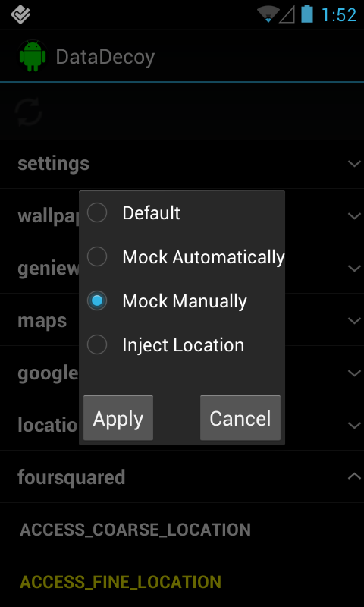
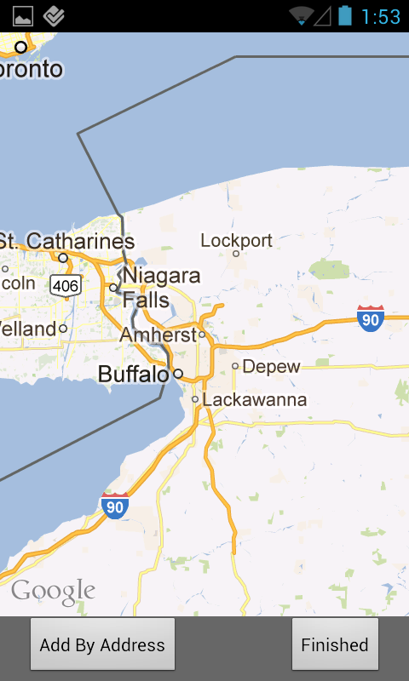

Slide 12
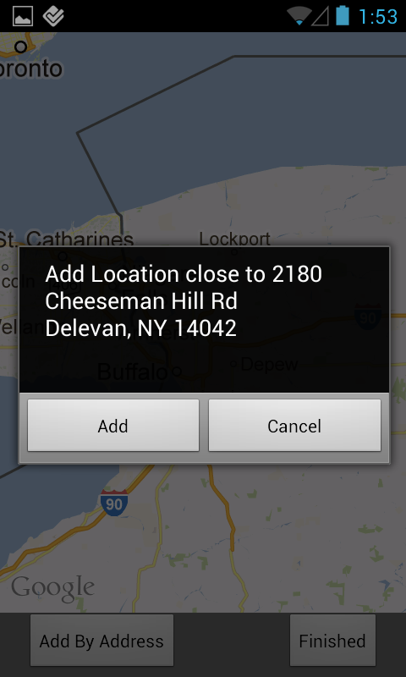
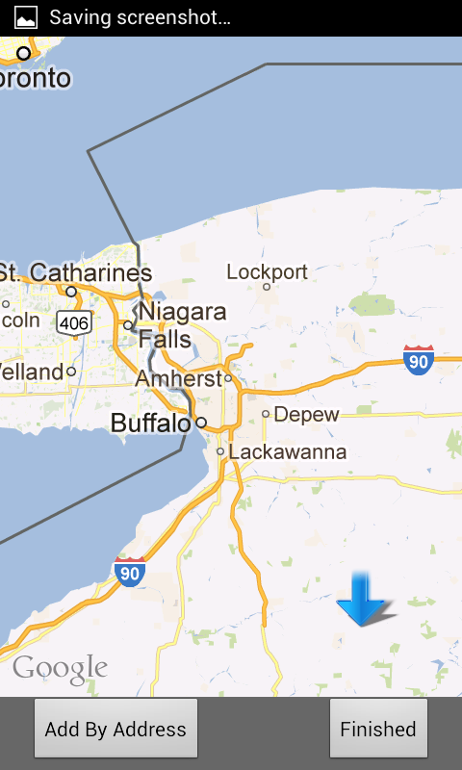
Adding Locations through touch

Slide 13
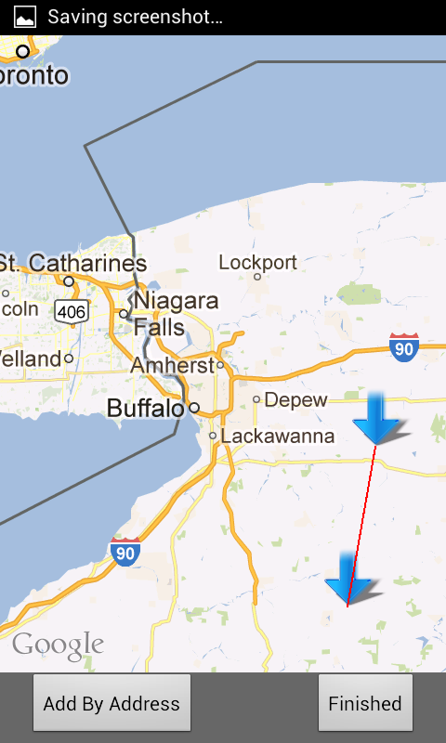
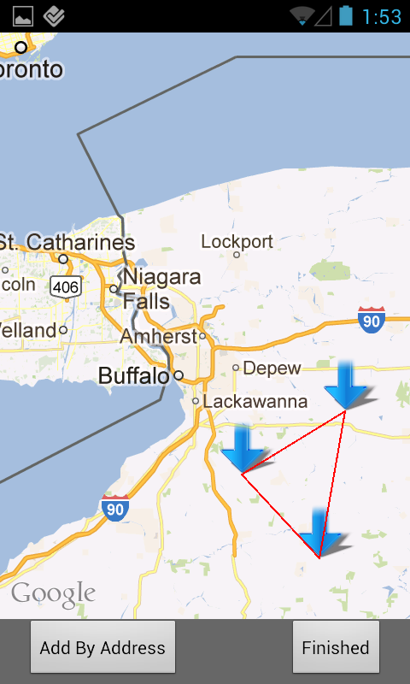
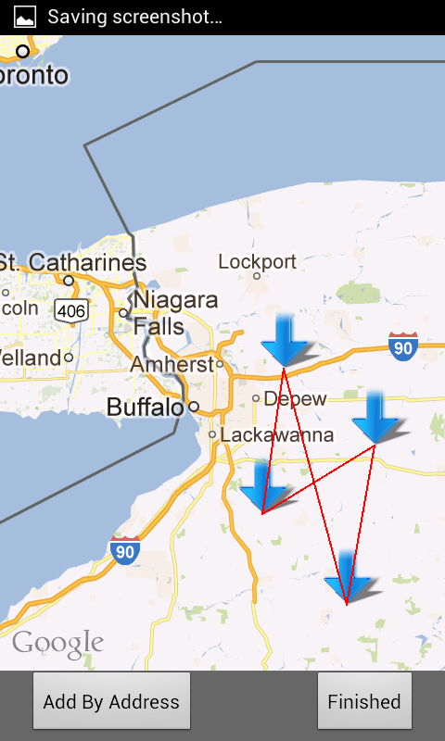

Slide 14
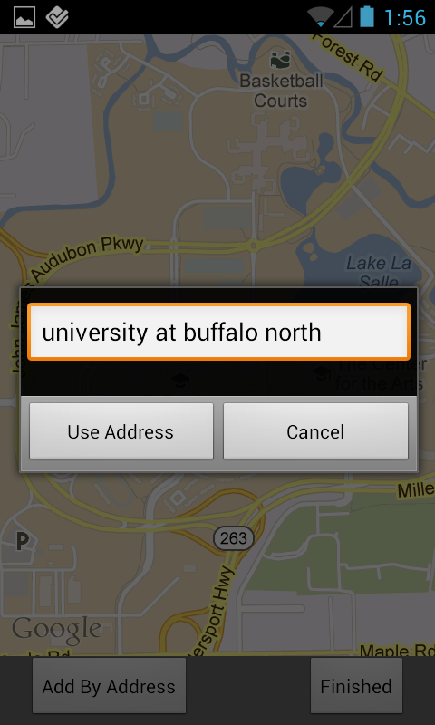
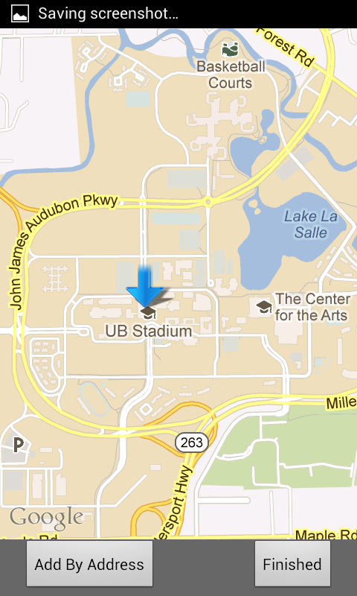
Adding through address

Slide 15
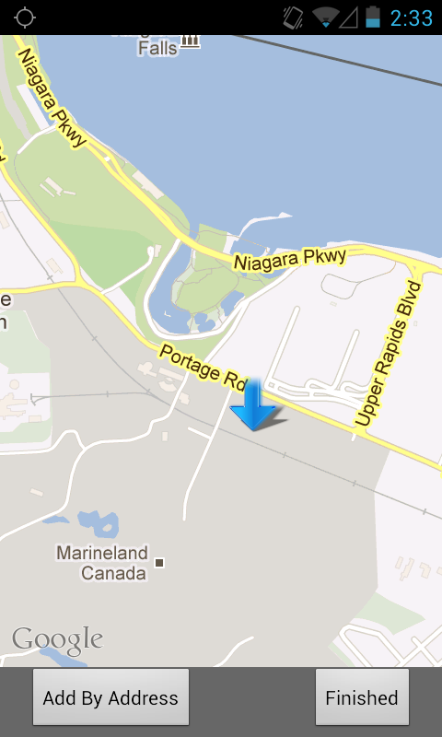
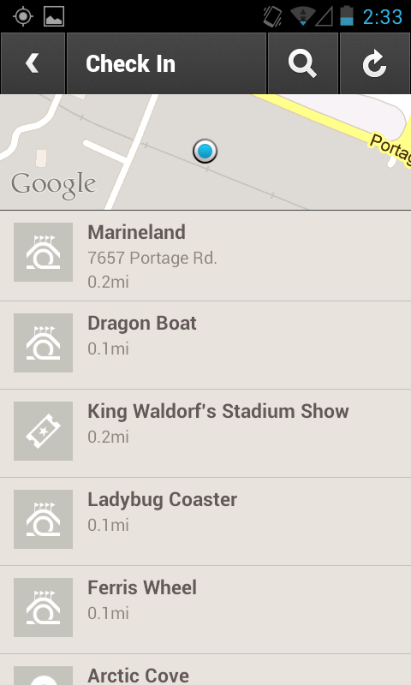
Manual Mocking in Foursquare

Slide 16
Demonstrations
Automatic Mocking with Foursquare
Manual Mocking with Foursquare including making GPS traces through the UI
Injecting GPS coordinates

Slide 17
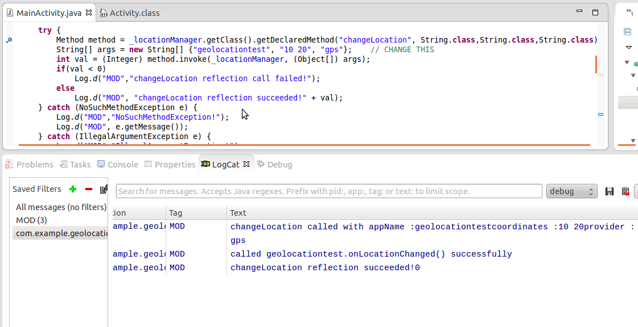

Slide 18
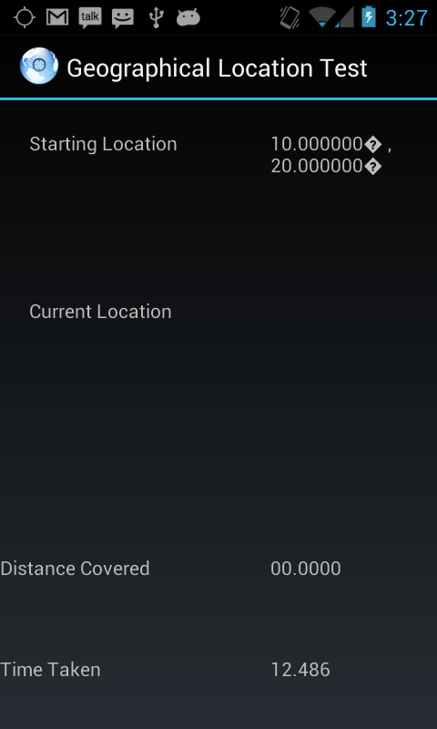

Slide 19
Future Work
Web site where users can upload, download, and vote on GPS traces that result in certain discounts. (Similar to RetailMeNot)
record and upload traces that give coupons
when browser tries to download a trace our app opens the file
Mock other data types?
Contacts (contacts’ ContentProvider)
IMEI (TelephonyManager)
Phone number (TelephonyManager)
Etc.

Slide 20
Advertisers vs. User’s Privacy
Unlikely that advertisers will change anything
RetailMeNot.com is very popular (they even have commercials), but retailers still use coupon codes
Not much advertiser’s can do
In order to collect data from the client, advertiser must use the phone’s sensors
It’s the user’s device, modifications might have been done to it
In general, a server on a public network cannot trust it’s clients
Programmer’s sometimes forget this. Then when a client doesn’t follow the protocol, the effects can be catastrophic.
Advertisers could use statistical analysis to catch people, but doubtful that it would be worth it

Slide 21


Slide 22
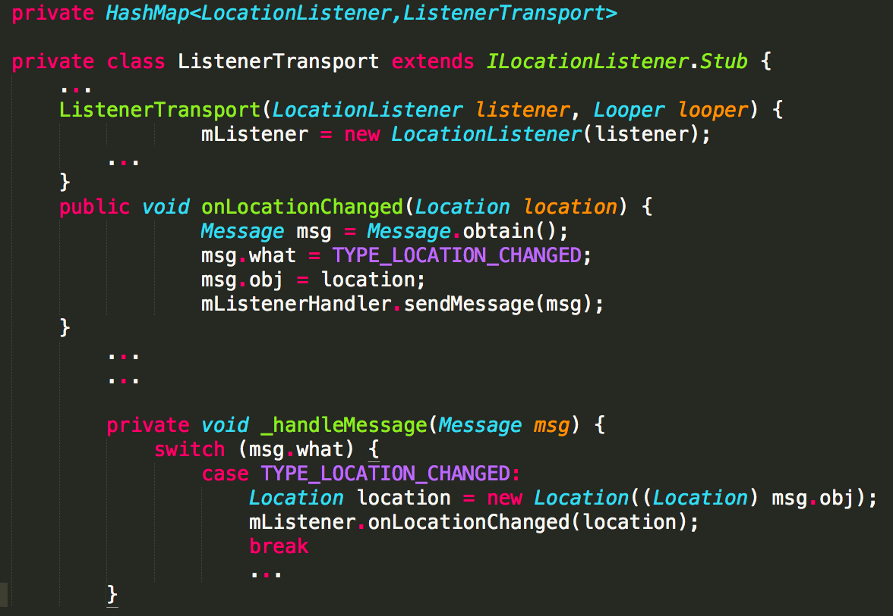
LocationManager

Slide 23
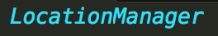
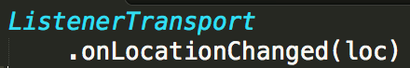
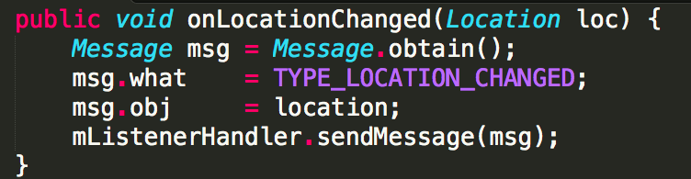
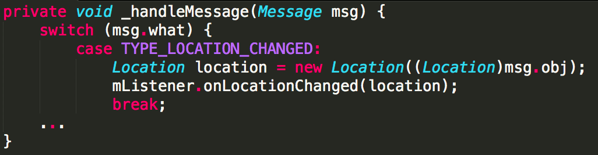
Location loc

Slide 24
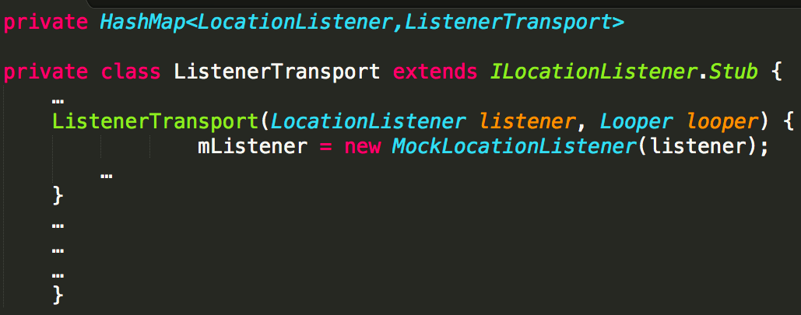
LocationManager

Slide 25
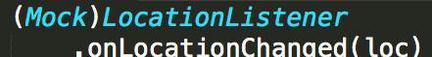
Location loc

Slide 26
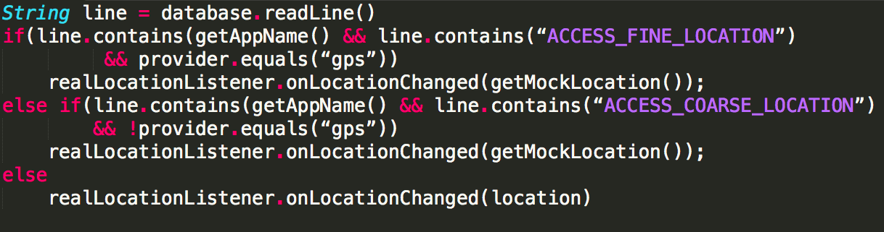
The Magic Pseudo code of ((MockLocationListener) LocationListener).onLocationChanged(Location location)

